Slide 1
Optical Analysis of different glass types and wave aberrations
Name : Ridhesh goti
University : Pandit deendayal petroleum university
Course : B.Sc. Physics (hons.) 3rd year
Supervisor : Mr. vaibhav dixit

Slide 2
Objectives
Find the dispersion for different glass types
Thermal analysis of glass types and how temperature affects the refractive index
Verification of the calculated data with reference data
Modelling of different optical systems with ray tracing method and analysing the different wave aberrations.

Slide 3
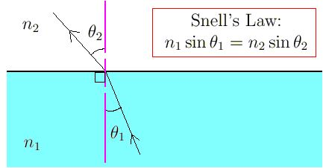
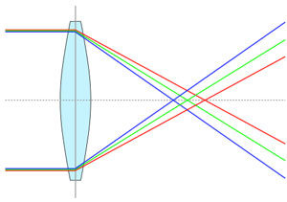
Basics of dispersion
Refractive index depends on the wavelength of the electromagnetic wave
Due to dispersion, different wavelengths bend with different angle after refraction
Dispersion mainly depends on the glass composition and surrounding conditions.

Slide 4

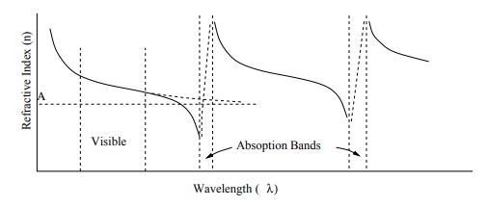


Mathematics behind dispersion
General dispersion relation is given by cauchy’s formula,
This Normal behaviour is valid only for certain wavelength range. Outside the range there is absorption region where refractive has not valid value.
In Anomalous dispersion, There are many absorption region and with almost same repetition of pattern.
Light’s electric field interacts with medium. Due to that refractive index is given by,
Sellmeier equation
Solution come from using forced oscillator and dielectric theory
General equation for medium with multiple absorption region

Slide 5

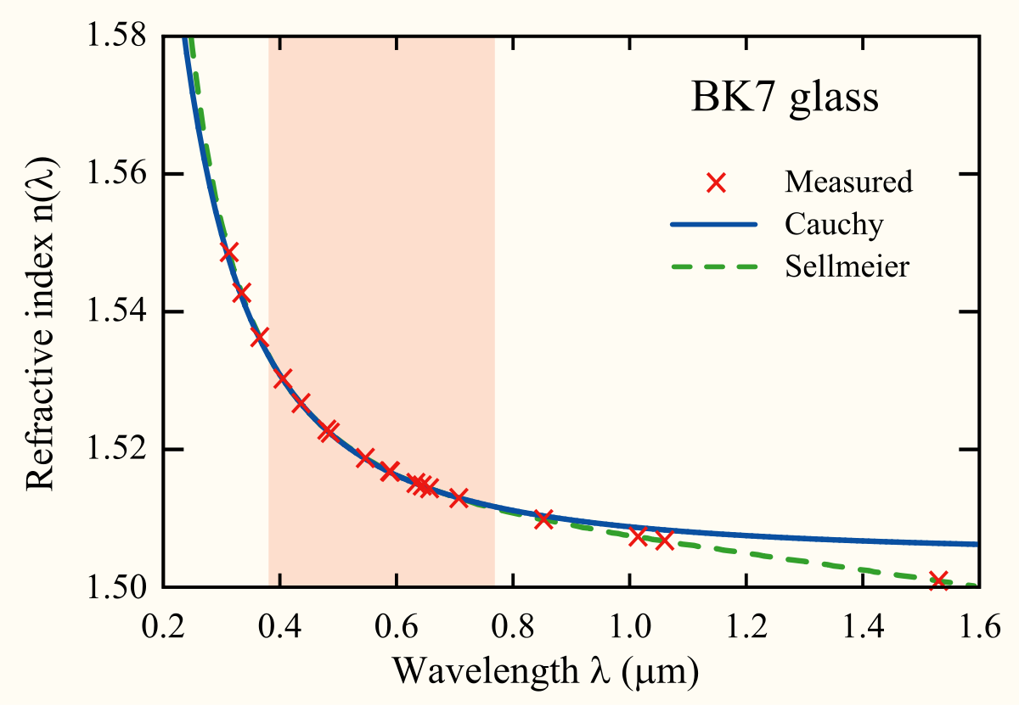
Measurement of dispersion and trends
Abbe number : Low abbe number means that dispersion is high and vice versa.
nD, nF, nC are refractive index of material at wavelengths of Fraunhofer D,F and C lines(589.3 nm, 486.1 nm, 656.3 nm respectively).
Flint glass has abbe number V < 50 and crown glass has V > 50.
General relation trends :
(1) Refractive index of substance increases with decreasing of wavelength
(2) The rate of change becomes greater at shorter wavelength.

Slide 6
ZEMAX catalogues
There are 13 dispersion formulas for different glass types. ZEMAX catalogues provide the experimentally verified constants values in catalogues (ohara, sumita, schott).
How to read catalogues (schott – N-BK7)
NM N-BK7 2 517642.251 1.5168 64.17 0 1
GC step 0.5 available
ED 7.100000 8.300000 2.510000 -0.000900 0
CD 1.039612120E+00 6.000698670E-03 2.317923440E-01 2.001791440E-02
1.010469450E+00 1.035606530E+02 0.000000000E+00 0.000000000E+00
TD 1.860000E-06 1.310000E-08 -1.370000E-11 4.340000E-07 6.270000E-10
1.700000E-01 2.000000E+01
OD 1.0000 1.0000 0.0000 1.0000 2.3000 2.3000
LD 3.00000E-01 2.50000E+00
IT 3.00000E-01 5.00000E-02 2.50000E+01
IT 3.10000E-01 2.50000E-01 2.50000E+01
...................................................................

Slide 7
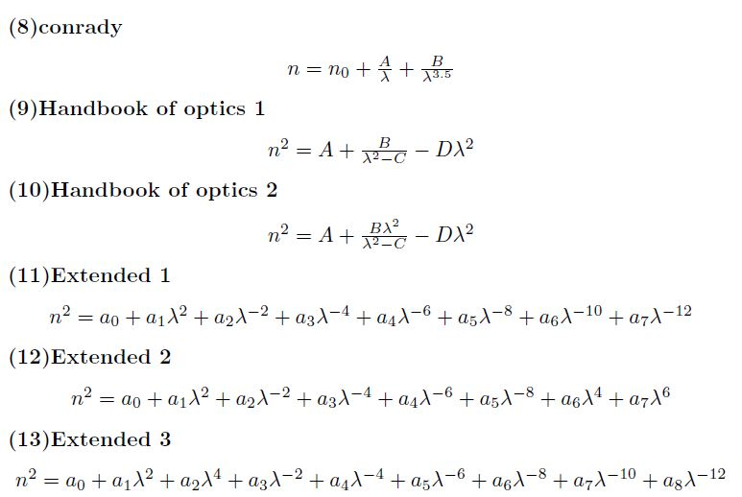
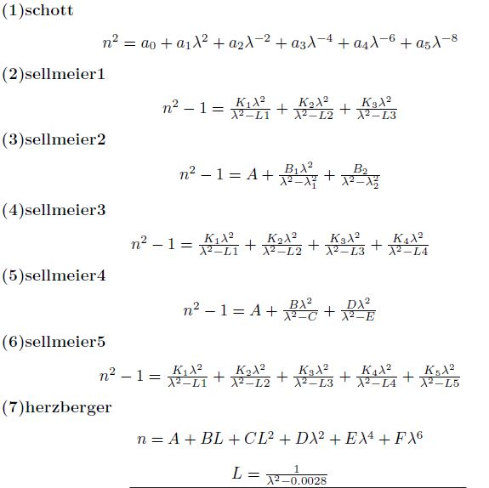

Slide 8
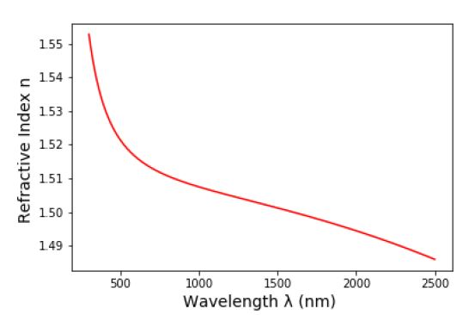
Dispersion data for N-BK7 glass
Glass name : N-BK7
Wavelength range : 300 nm to 2500 nm
Reference temperature : 20 C
Pressure : 101325 Pa
Abbe number : 64.13319920721142
No | Wavelength (nm) | Refractive index
1 | 400 | 1.5308485382492993
2 | 1060 | 1.5066875568966998
3 | 2000 | 1.4945016229008292

Slide 9
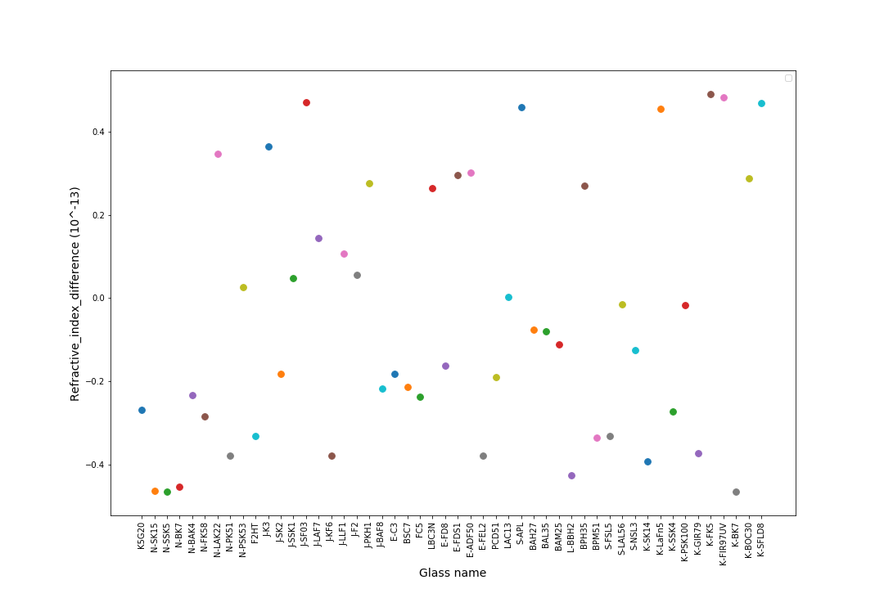
Verification of data

Slide 10
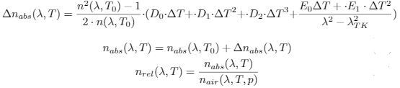
Thermal Analysis
RI(Refractive index) depends on pressure and temperature
Two types : (1) Absolute RI at pressure = 0 Pa (2) Relative RI at given pressure
The refractive index from catalogues are at reference temperature and one atmosphere pressure (101330 Pa).
Differentiating w.r.t to temperature

Slide 11





Thermal Analysis....contd
Refractive index of air,
Change in relative RI,
Final equation

Slide 12
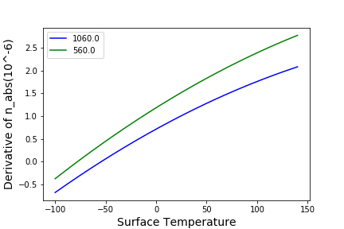
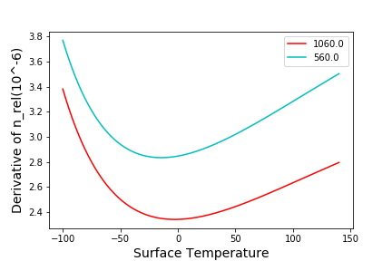
Thermal Analysis of N-BK7
The rate for 560 nm is greater than 1060 nm wavelength. Here the temperature range is -100 to 140 celsius in the first figure.
The rate is decreasing till 0 celsius and increasing
after that in the second figure. (Pressure = 10320 Pa)

Slide 13
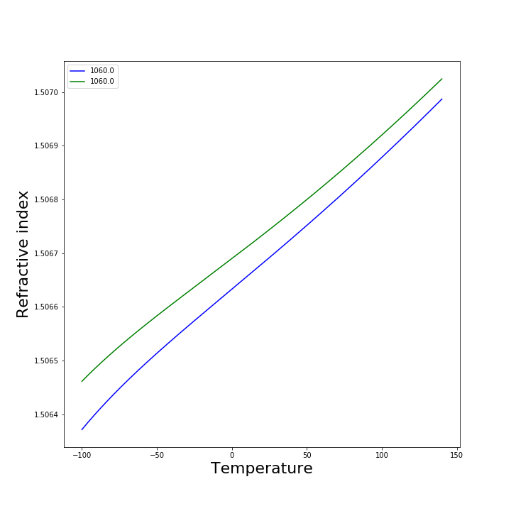
Thermal Analysis of N-BK7...cond
Green colour for pressure 90000 Pa
Blue colour for pressure 103250 Pa
Wavelength : 1060 nm
Pressure (Pa) | Temperature (C) | Refractive index
103250 | 20 | 1.5066875568966998
 | 40 | 1.506727581074728
90000 | 20 | 1.506732895237537
 | 40 | 1.5067772329259013

Slide 14
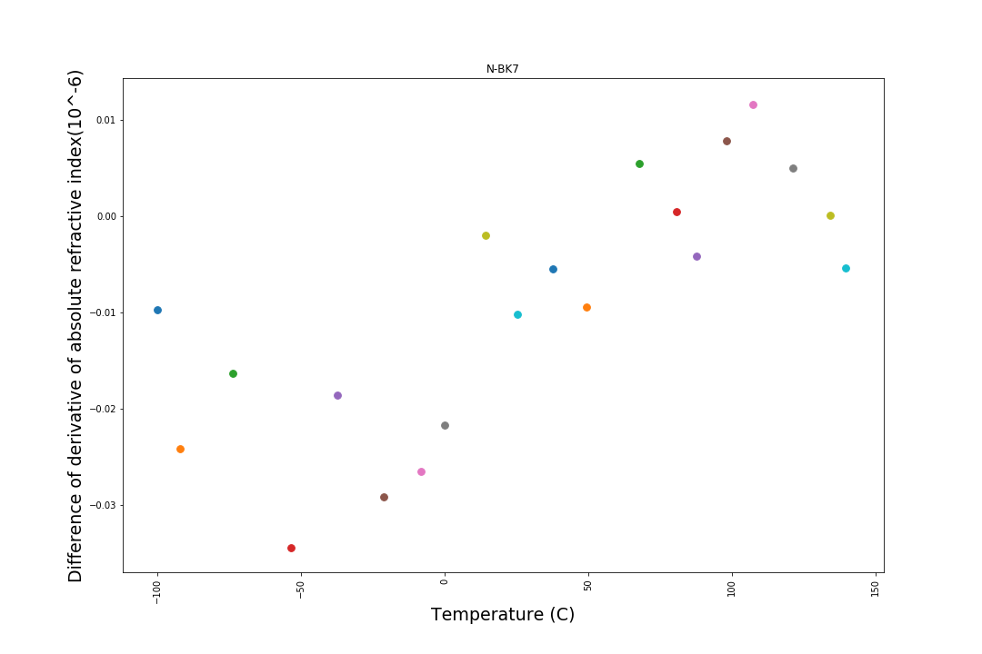
Verification of the thermal analysis data (RI absolute)

Slide 15
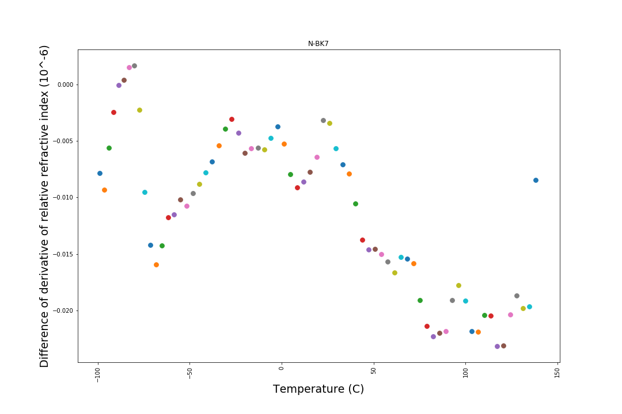
Verification of the thermal analysis data (RI relative)

Slide 16
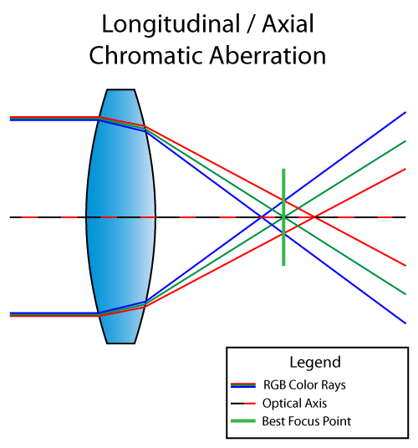
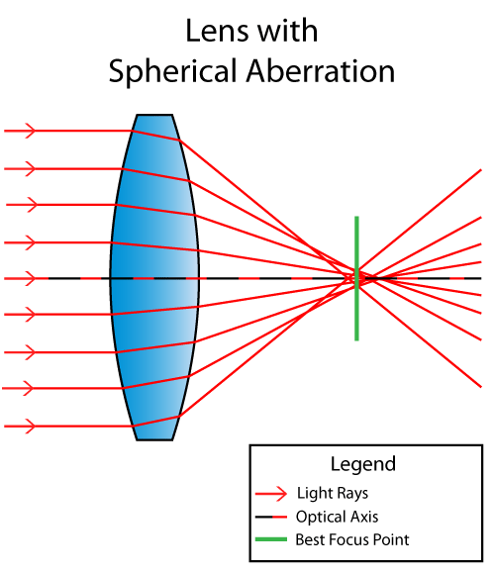
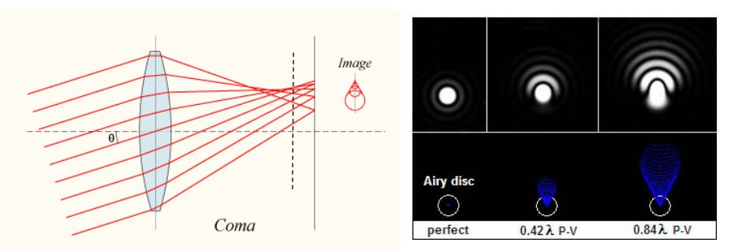
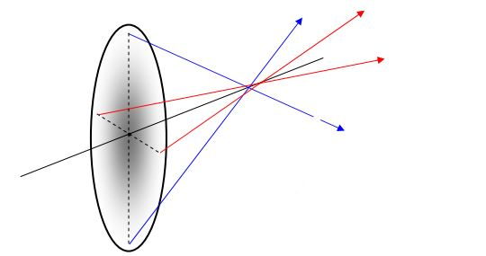
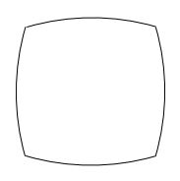
Aberrations

Slide 17


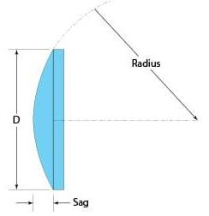
Aberrations...contd
Aspheric surfaces are useful to reduce the aberrations.
Aspheric surfaces are defined by sag factor
Radius of curved surface at each points,
Using ray tracing method, OPL(optical path length)
and final image height could be found very precisely.
Optical path difference from OPL gives the phase difference of the wave.

Slide 18
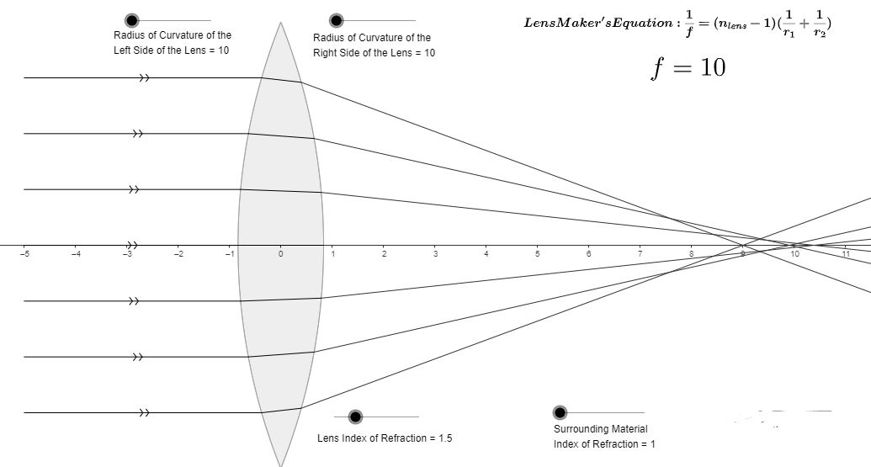
Modelling of ray tracing method

Slide 19
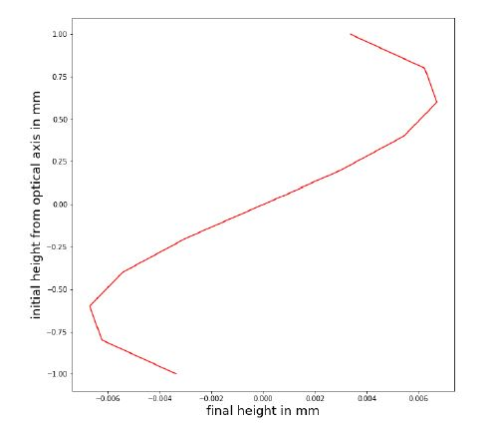
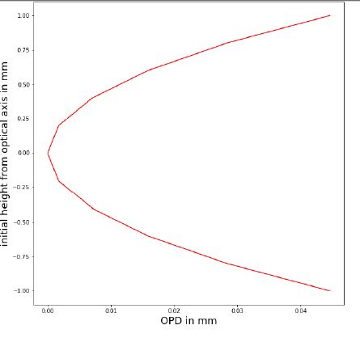
Results from modelling

Slide 20
Applications
To get dispersion relation for given glass type
Thermal analysis of glass gives the precise value of refractive index at given conditions (temperature, pressure)
From ray tracing method, precise aberration could be founded and modelling of telescope
Defining sag factor, aspheric surfaces use into reduction of aberration.

Slide 21
References
https://www.math.ubc.ca/~cass/courses/m309-01a/chu/Fundamentals/snell.htm
https://en.wikipedia.org/wiki/Cauchy%27s_equation
https://refractiveindex.info/?shelf=glass&book=SCHOTT-BK&page=N-BK7
https://www.schott.com/d/advanced_optics/3794eded-edd2-461d-aec5-0a1d2dc9c523/1.1/schott_tie-19_temperature_coefficient_of_refractive_index_eng.pdf
https://nptel.ac.in/courses/112105165/lec28.pdf
https://www.schott.com/d/advanced optics/3794eded-edd2-461d-aec5-0a1d2dc9c523/1.1/schott tie-19 temperature coefficient of refractive index eng.pdf
https://ophysics.com/l14.html
https://www.edmundoptics.com/ViewDocument/all-about-aspheric-lenses-en.pdf

Slide 22
Verification of RI vs wavelength (raw data)
Glass name | Glass catalogue | Wavelength | Refractive index in web | Refractive index calculated | Difference of RI
K5G20 | SCHOTT-K | 1.435 | 1.508314 | 1.508314 | -2.69E-14
N-SK15 | SCHOTT-SK | 1.417 | 1.605526 | 1.605526 | -4.64E-14
N-SSK5 | SCHOTT-SSK | 1.425 | 1.638549 | 1.638549 | -4.66E-14
N-BK7 | SCHOTT-BK | 1.4 | 1.502496 | 1.502496 | -4.53E-14

Slide 23
Verification of thermal analysis (raw data for N-BK7)
Absolute change of RI with temperature
Relative change of RI with temperature
Given change in reference | Calculated by formula | Difference(10^-6)
-6.91E-01 | -0.68148 | -0.00973
-5.84E-01 | -0.55973 | -0.02421
-2.98E-01 | -0.28162 | -0.01636
-2.38E-02 | 0.010703 | -0.03453
2.15E-01 | 0.233072 | -0.01857
Given change in reference | Calculated by formula | Difference(10^-6)
3.27E+00 | 3.274056 | -0.00802
3.20E+00 | 3.205571 | -0.00948
3.13E+00 | 3.135894 | -0.00578
3.07E+00 | 3.069411 | -0.00264
3.00E+00 | 3.004968 | -0.00022

Slide 24
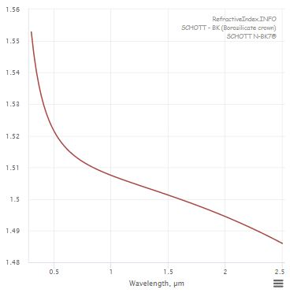
From reference data for RI vs wavelength

Slide 25
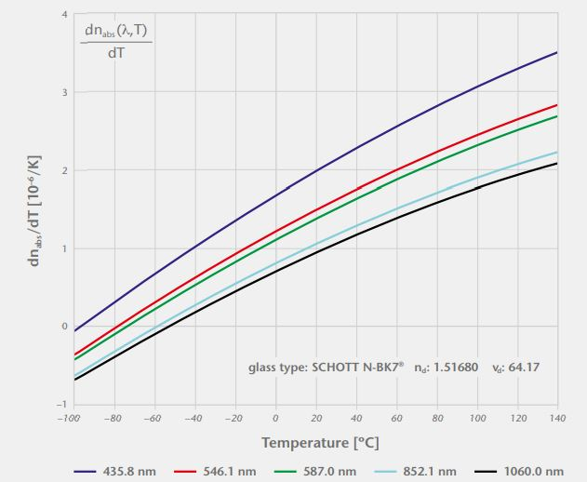
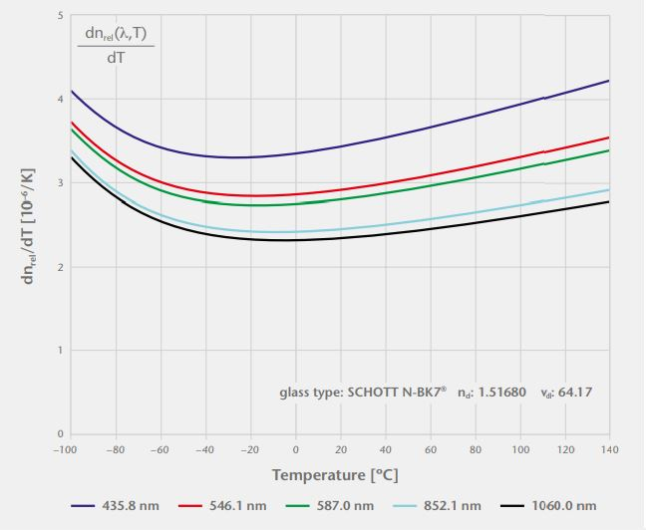
From reference data for thermal analysis (N-BK7)
RI absolute
RI relative

Slide 26
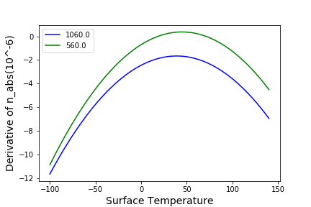
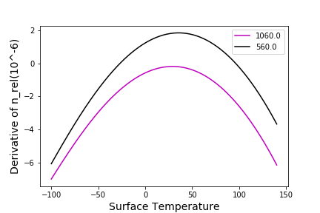
Thermal analysis of K-SFLD 14

Slide 27
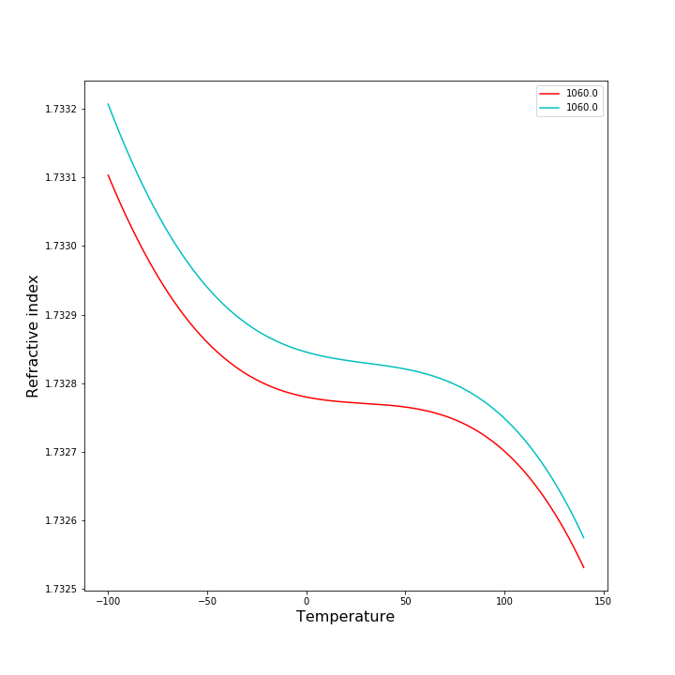
Thermal analysis of K-SFLD 14...contd
Light blue colour for pressure at P=90000 Pa and red colour for pressure P = 103250 Pa

